Slide 1
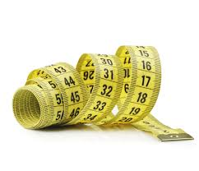
My Shape and Measurement Interactive Notebook
Name
Class
Teacher Mrs Keen
Semester 1
Term 2
1

Slide 2
Contents
Glossary or Formula Page
Page
Date
Description
2
3

Slide 3
Tasks
24
7
30
Essential Question
Questions
Notes
Summary

Slide 4
24
7
30
Date
Circles
EQ – What do I need to know about circles?

Slide 5
Definition of a circle
A 2D shape
1 edge
No corners

Slide 6
24
7
30
Date
Circles
EQ – What do I need to know about circles?
What is a circle?
A 2D shape that has only one edge (or side) and no vertices (corners).

Slide 7
Circumference and Radius.
diameter
circumference
radius
The circumference of a circle is the boundary of the circle.
A line segment drawn from the centre of a circle to the circumference is the radius. Every radius in a circle is equal in length.
A line segment drawn through the centre from one side of a circle to its opposite side is called the diameter. It is double the length of the radius.

Slide 8
24
7
30
Date
Circles
EQ – What do I need to know about circles?
What is a circle?
A 2D shape that has only one edge (or side) and no vertices (corners).

Slide 9
24
7
30
Date
Circles
EQ – What do I need to know about circles?
What is a circle?
A 2D shape that has only one edge (or side) and no vertices (corners).
Circumference

Slide 10
24
7
30
Date
Circles
EQ – What do I need to know about circles?
What is a circle?
A 2D shape that has only one edge (or side) and no vertices (corners).
Circumference
The total measurement around the edge of the circle.

Slide 11
24
7
30
Date
Circles
EQ – What do I need to know about circles?
What is a circle?
A 2D shape that has only one edge (or side) and no vertices (corners).
Circumference
The total measurement around the edge of the circle.
Diameter

Slide 12
24
7
30
Date
Circles
EQ – What do I need to know about circles?
What is a circle?
A 2D shape that has only one edge (or side) and no vertices (corners).
Circumference
The total measurement around the edge of the circle.
Diameter
The straight line measurement from one side to the other, passing through the centre of the circle.

Slide 13
24
7
30
Date
Circles
EQ – What do I need to know about circles?
What is a circle?
A 2D shape that has only one edge (or side) and no vertices (corners).
Circumference
The total measurement around the edge of the circle.
Diameter
The straight line measurement from one side to the other, passing through the centre of the circle.
Radius

Slide 14
24
7
30
Date
Circles
EQ – What do I need to know about circles?
What is a circle?
A 2D shape that has only one edge (or side) and no vertices (corners).
Circumference
The total measurement around the edge of the circle.
Diameter
The straight line measurement from one side to the other, passing through the centre of the circle.
Radius
The straight line measurement from the centre of the circle to the edge.

Slide 15
24
7
30
Date
Circles
EQ – What do I need to know about circles?
What is a circle?
A 2D shape that has only one edge (or side) and no vertices (corners).
Circumference
The total measurement around the edge of the circle.
Diameter
The straight line measurement from one side to the other, passing through the centre of the circle.
Radius
The straight line measurement from the centre of the circle to the edge.
The radius is half the length of the diameter.

Slide 16
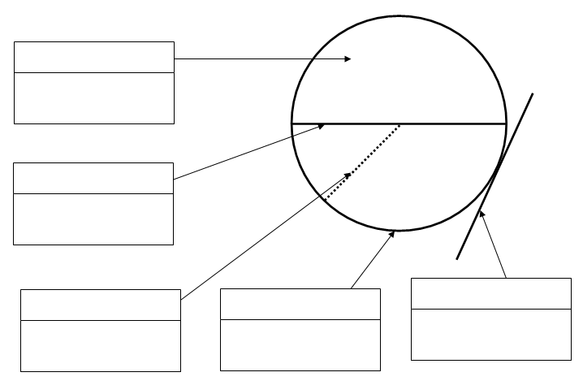
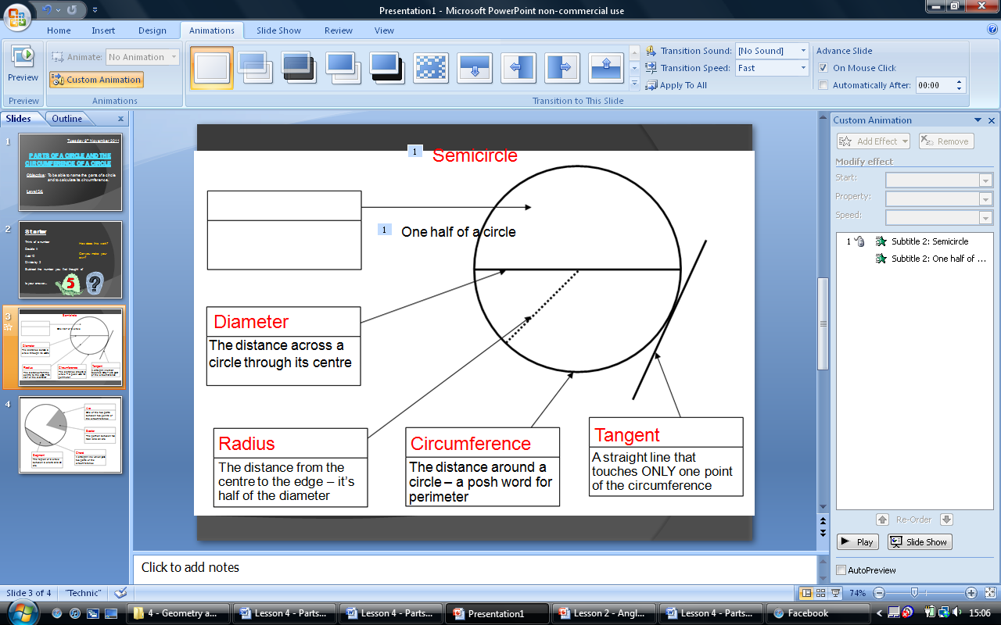
Other Parts of a Circle – For our Glossaries
Semicircle
One half of a circle
Diameter
The distance across a circle through its centre
Tangent
Radius
Circumference
A straight line that touches ONLY one point of the circumference
The distance from the centre to the edge – it’s half of the diameter
The distance around a circle – a posh word for perimeter

Slide 17
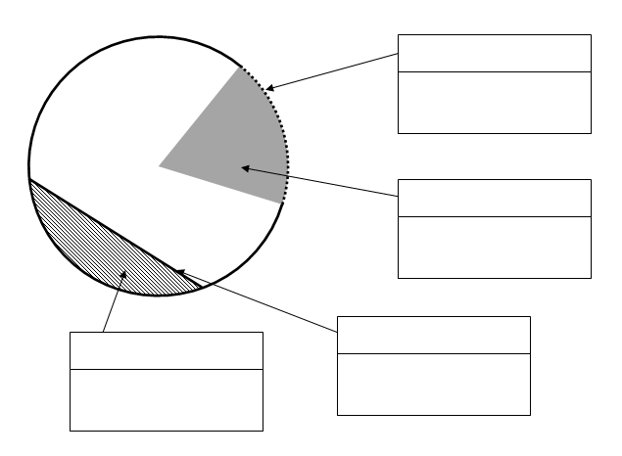
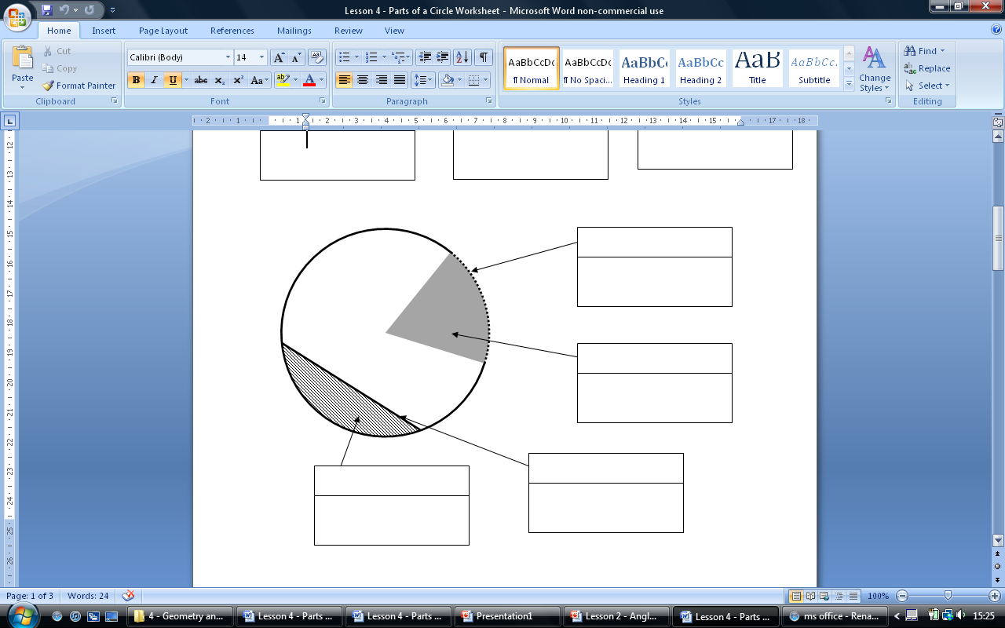
Other Parts of a Circle – For our Glossaries
Arc
One of the two parts between two points of the circumference
Sector
The portion between two radii and an arc
Chord
Segment
A straight line which joins two parts of the circumference
The region of a circle between a chord and an arc

Slide 18
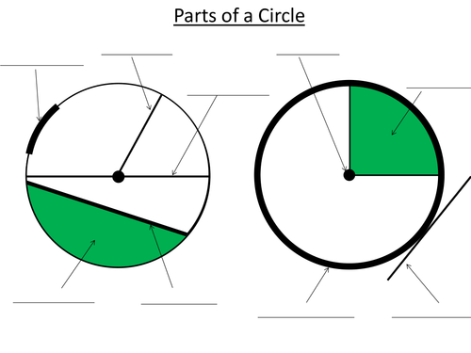
Complete Parts of a Circle Handout: Label them, then cut out and Paste
both in your INB’s

Slide 19
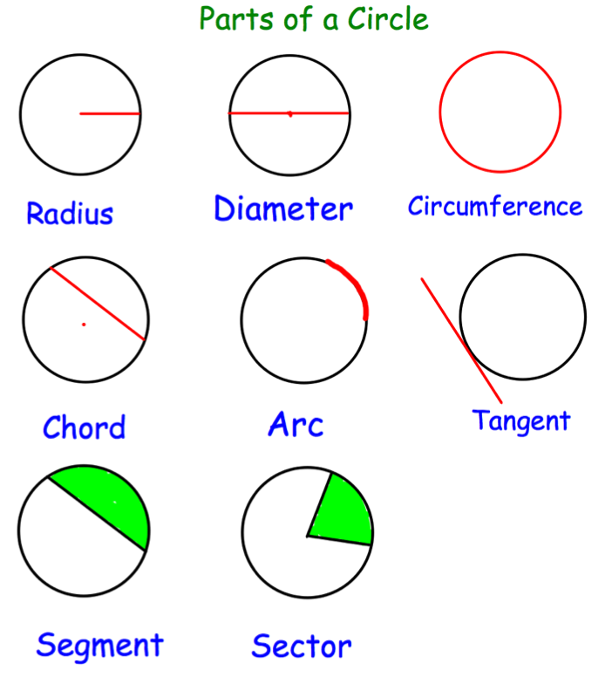

Slide 20
Expansion

Slide 21
Notes Review
24, 7 ,30
Date
Title
Essential question
Notes complete
Notes complete with colour and diagrams
Questions completed
Contents page filed in
Formula page filled in

Slide 22
Homework
Review your notes and write a summary answering the essential question.

